Slide 1
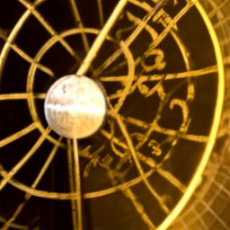
Numbers of News Articles About Names of Minor Planets Reflect Their Degree Differences from the Sun
Renay Oshop, Boulder, USA
AyurAstro.com
with Anton Coops, Leiden, Netherlands
Dubbhism.org
(entirely AI-generated image when I fed into it: “astrology” and “science”)

Slide 2
Road map
1. An example to help ground us
2. A short animated video to help explain what science I am using
3. A mutual conversation about the lived experience in the joys and difficulties of doing the science while supporting data is on screen.

Slide 3
What are we really talking about?
Minor planets. These include a lot of categories from astronomy: "minor planets", "Amor asteroids", "Apollo asteroids", "asteroid belt", "Aten asteroids", "dwarf planets", "Kuiper Belt objects", "scattered disk objects", "near-Earth asteroids", "Plutoids", "trans-Neptunian objects", "Jupiter Trojan asteroids", "centaur asteroids", "inner main belt asteroids", "main belt asteroids", "Mars crossing asteroids", "outer main belt asteroids”.
These categories might behave differently, but we will consider them here as one.
In astrological asteroid theory, the name as archetype gives the interpretive meaning of the placement.

Slide 4
Ocasio-Cortez’s asteroid: part of prize for second place in high school at Intel International Science Fair
What for example is the relationship between the number of Ocasio-Cortez stories in the news and her asteroid’s degree difference to the Sun?
We are talking about literary qualitative traits in a new kind of literature: Google News stories.
Thus, ours is a quantitative question that ultimately refers to literary quality, just as astrology is a link between number and text.

Slide 5
Example: The last time the Ocasio-Cortez asteroid was conjunct Sun was on Oct 7, 2021 when Sun and the asteroid were in Tropical Libra.
Sept 13, 2021: she wore the famous “Tax the Rich” dress at the Met Gala.
Oct 3, 2021: she was also on Face the Nation.
Throughout early Oct 2021: she was also in a very public Twitter feud with Joe Manchin.

Slide 6
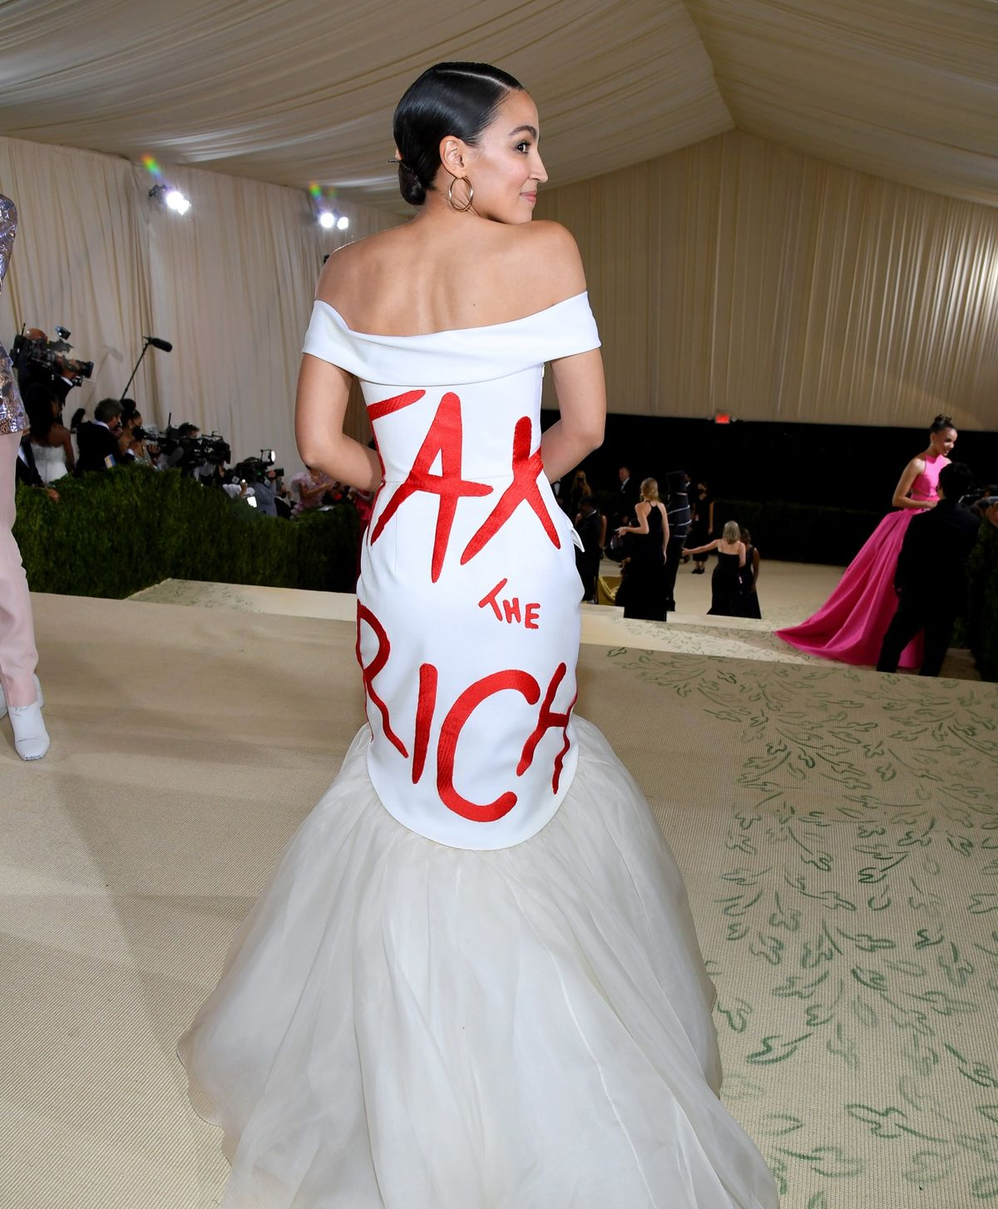
Asteroid and Sun conjunction in Tropical LIBRA aligns with themes within the story.
Dress
Museum
The active feminine
Perhaps even the righting of wrongs through the scales of commerce.

Slide 7
So, we are ultimately talking about stories
But in a quantitative way.

Slide 8
We first need to talk about something, namely p-values.
In truth, you already practice the principle of p-values every day.
Think of p-values as a more precise way to codify Occam's Razor which you may remember from school.
Says "all other things being equal, the simplest explanation is the likeliest".
MD friend says she was taught as a diagnostician: "When you hear hooves, look first for a horse, and only after that, a zebra"

Slide 9
A practical example:
Let's say there is a strange machine on the street.
You are told that pushing a button will result in either a red ball or a blue ball, and
if you get a red ball that means either you won a 1 in a trillion lottery OR a 1 in 100 church raffle. Blue means you won neither.
There is no other possibility.
The evidence is you get a red ball. What is your rational conclusion about the most likely scenario (not the most desirous one)?

Slide 10
We first need to talk about something, namely p-values.
I think of p-values as a more precise way to codify Occam's Razor which you may remember from school.
For example, let's say that there is a broken vase in a room with only one rambunctious dog and one calm, human friend. Video confirms they were the only ones in the room since you were last there and saw an unbroken vase.
Which is more likely? That the dog broke the vase or the friend did?
The default assumption, the null hypothesis, is that the dog did it.
The only possible other explanation, the alternate hypothesis, is that the human did it.
Let's say the dog has done it often before, in fact 3 out of 4 times.
The likelihood, the p-value, of the null hypothesis is thus pretty high, 0.75 or 75% of the time, reflecting ¾.

Slide 11
But what if more evidence is included?
Namely, the dog is in a dog pen with a lock on it for which only you have the key.
Now, the likelihood of the dog breaking the vase is vanishingly small, say 1 in 10000 (or 0.0001). The p-value for the alternate hypothesis is thus 0.0001 which is less than 0.05, the scientifically, culturally accepted cut off for dropping the default assumption.
Occam's Razor and statistics would now say that with the new evidence the alternate hypothesis is supported. That is, we instead must conclude that the friend likely broke the vase.
Note that we have to say "likely", not "certainly". There is still some non-zero possibility the dog somehow broke it (the 1 in 10000 chance).

Slide 12
So what is our working alternate hypothesis, i.e., what is an alternative to a default assumption about astrology?
We hypothesize that as the Sun approaches a minor planet by astrological degree, there will be more news articles mentioning its name in Google News as an alternative to the null hypothesis that there will be the same number of news articles there.
Pearson’s chi square p-value for the measurement of an increase in news articles should be less than alpha (possibility of false positive) = 0.05.
Just as importantly, beta (1 – possibility of false negative) will need to be greater than 0.90.

Slide 13
Other things we are curious about:
Perhaps, other Sun angles than conjunctions will also see an increase in news articles or some other pattern that is meaningful to the astrologer.
Peripherally, we are also interested in data that may support empirical derivation of houses, orbs, harmonics, etc., along the way.
Here is our story.

Slide 15
Personal background and notes on my practice:
I was a computational biologist for five years early in my career. I subsequently attended Vasant Lad's Ayurvedic Institute, a kind of Hogwart's, which also included 6 months of training in India, and embarked on an international 24-years-and-counting journey to study Jyotisha (Vedic astrology), following both parents by becoming a professional astrologer. I was also lucky enough to take all of Hart de Fouw's American astrology and palmistry courses. As an astrologer, I still feel like a computational biologist.
Now, I find myself quite busy with private readings, teaching Sanskrit, and focusing on advanced studies and scientific research of Jyotisha. I also love making astrologically inspired jewelry.

Slide 16
Doing science is, like any cultural act, a matter of telling stories. There tend to be at least three of them within any project.
Data analysis (yes, this is first)
Data cultivation
Data presentation

Slide 17
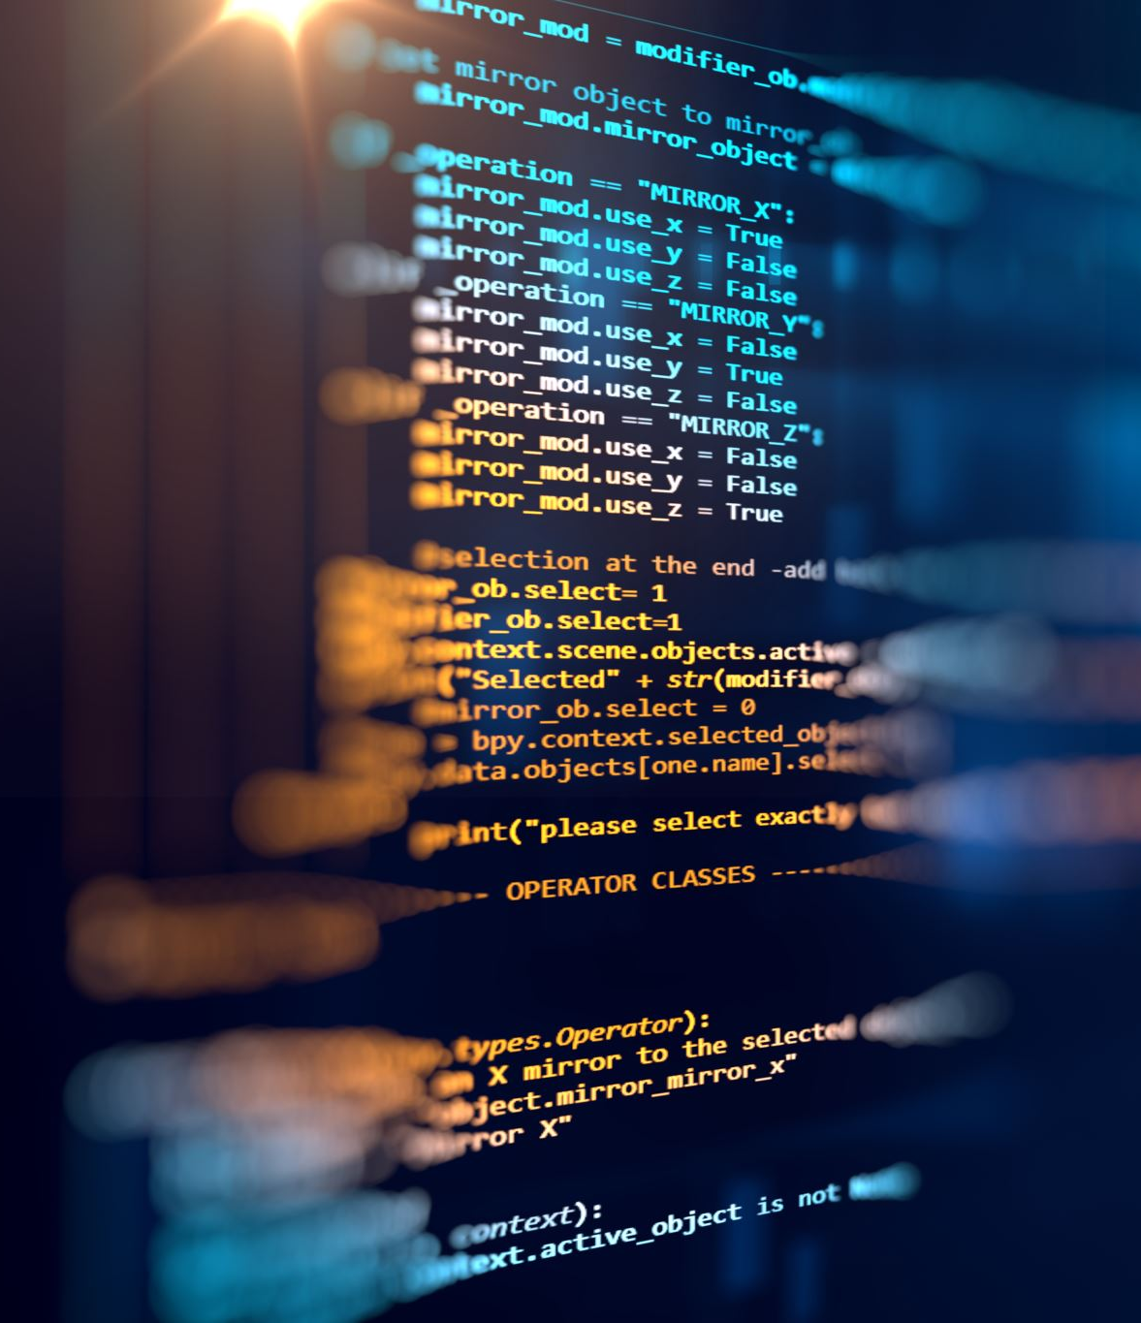
1. Data Analysis
Study benefitted by conceiving and coding this part first * [* denotes a key point in this presentation].
That way, from the start I knew what data I need.

Slide 18
Which also introduces a kind of “pre-registration”
a relatively new fashion in science,
involves declaring first on what and how you will do a study, i.e., aiming to win by hitting a pre-drawn bull’s eye vs. drawing the bull’s eye after the fact around the data and then calling it a win.
The first is pre-registration and usually recorded in public such as in this presentation now.
The second is “p-hacking” and a very bad but still somewhat common practice in science.

Slide 19
Questions then become:
What methods are we going to use?
What do these methods require?

Slide 20
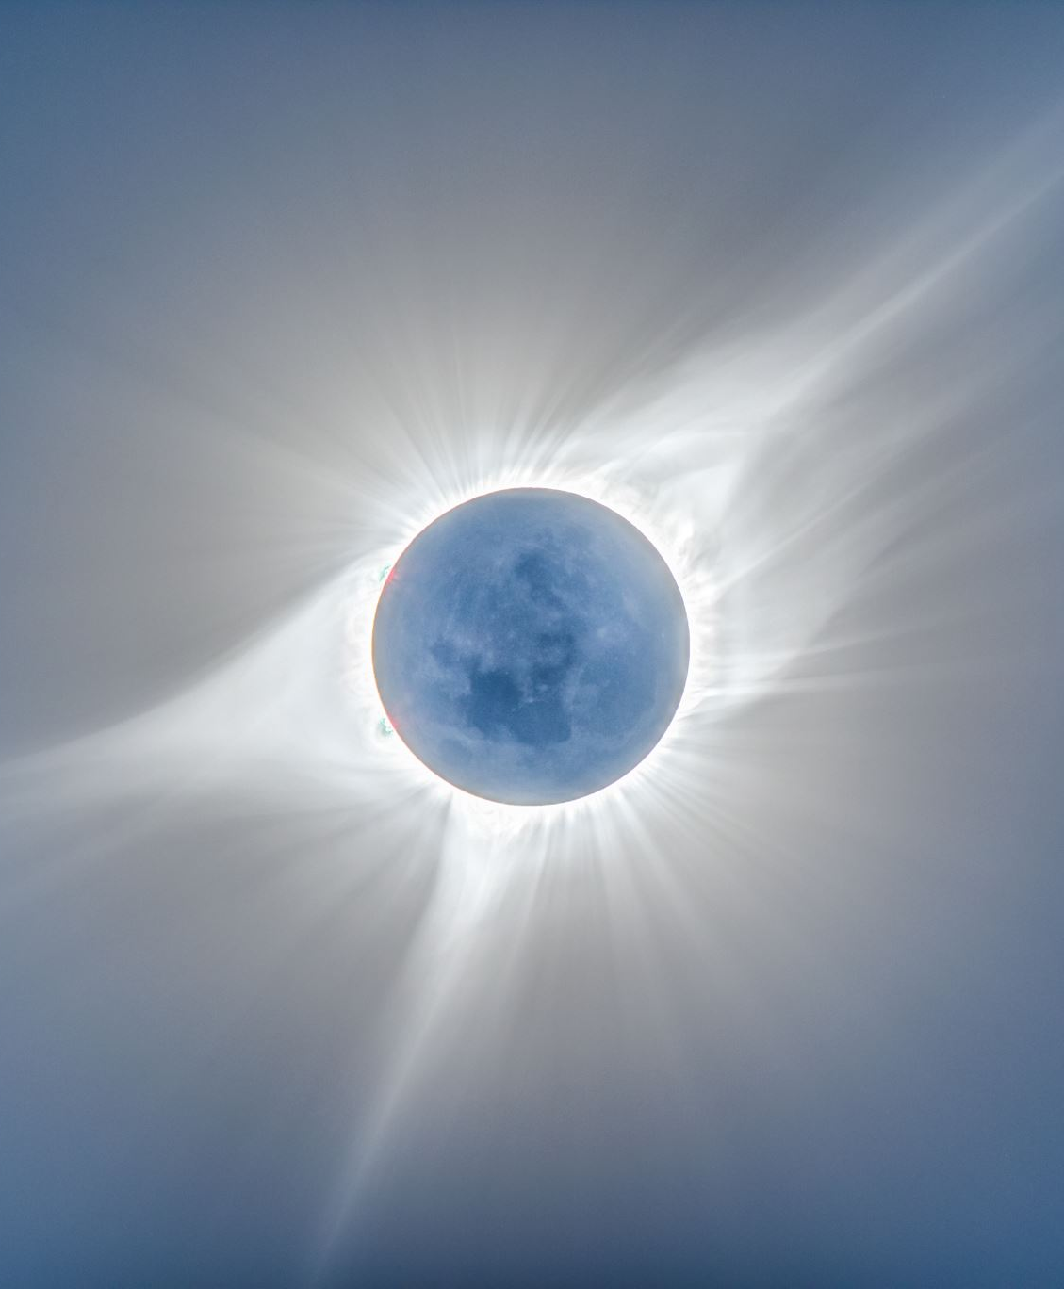
From musical and signal analysis
I knew that I wanted a picture* (worth a thousand words) of a circle that goes from 0 to 360 degrees with 0 representing a conjunction of the minor planet and the Sun, 90 representing a right angle with the minor planet ahead, 180 is an opposition, 270 is a right angle with the Sun ahead of the minor planet, and all degrees in between represented as well.

Slide 21
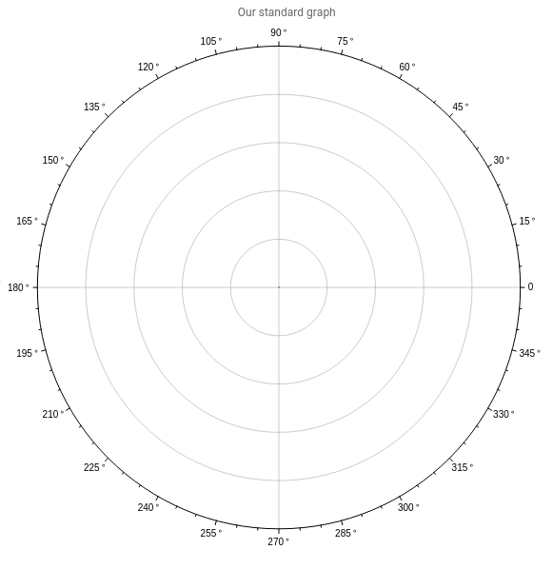
Note that we are following the convention from math, not astrology, in depicting these degrees.

Slide 22
Plotted in the circle will be
The number of articles in Google News at that astrological degree difference between the Sun and the minor planet.
Note that this approach is zodiac- and house-agnostic. We are just considering degree differences.

Slide 23
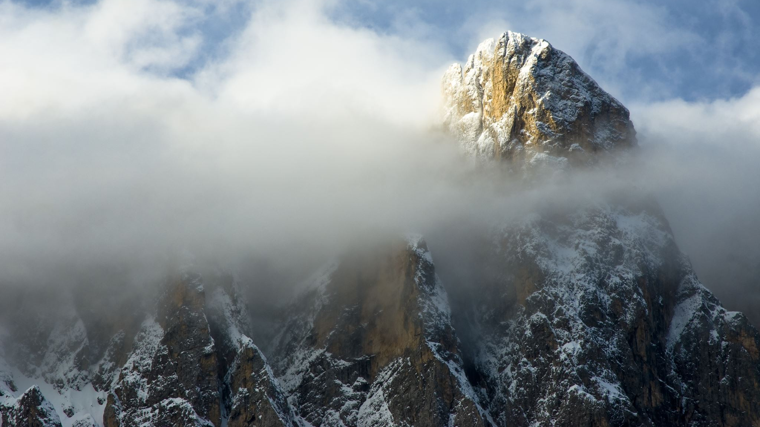
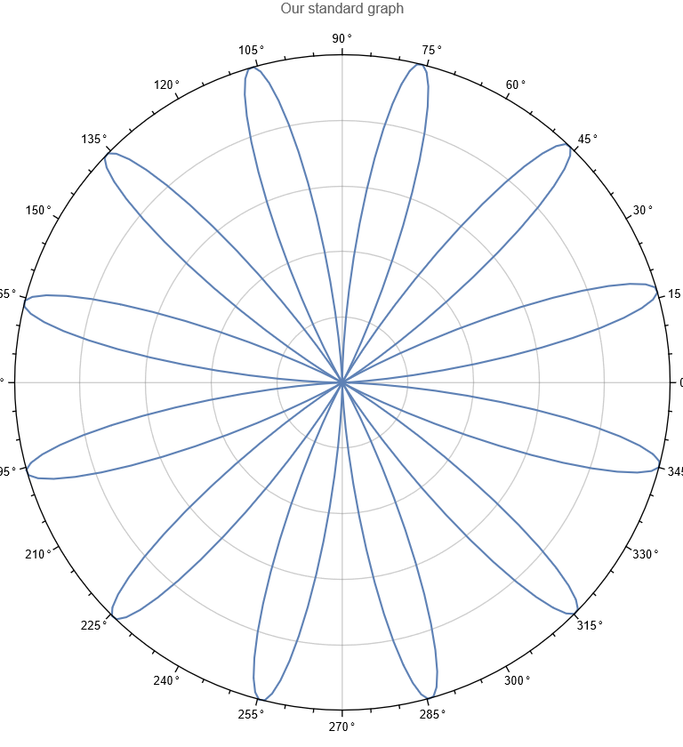
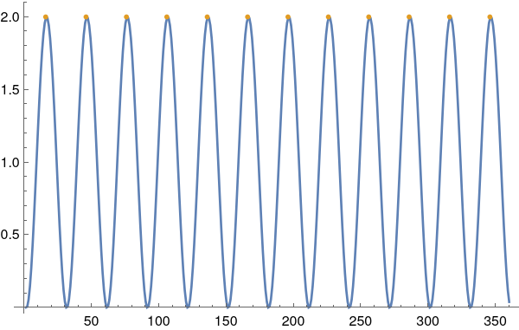
A very idealized and theoretical result

Slide 24
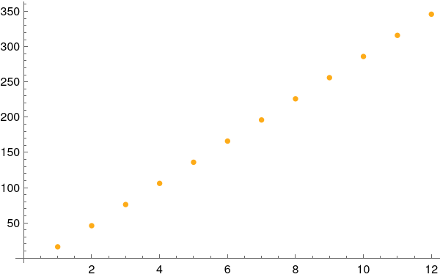
Peaks are at 15, 45, 75, 105, 135, 165, 195, 225, 255, 285, 315, and 345 degrees.
y = 15+ 30*x
A very idealized and theoretical result

Slide 25
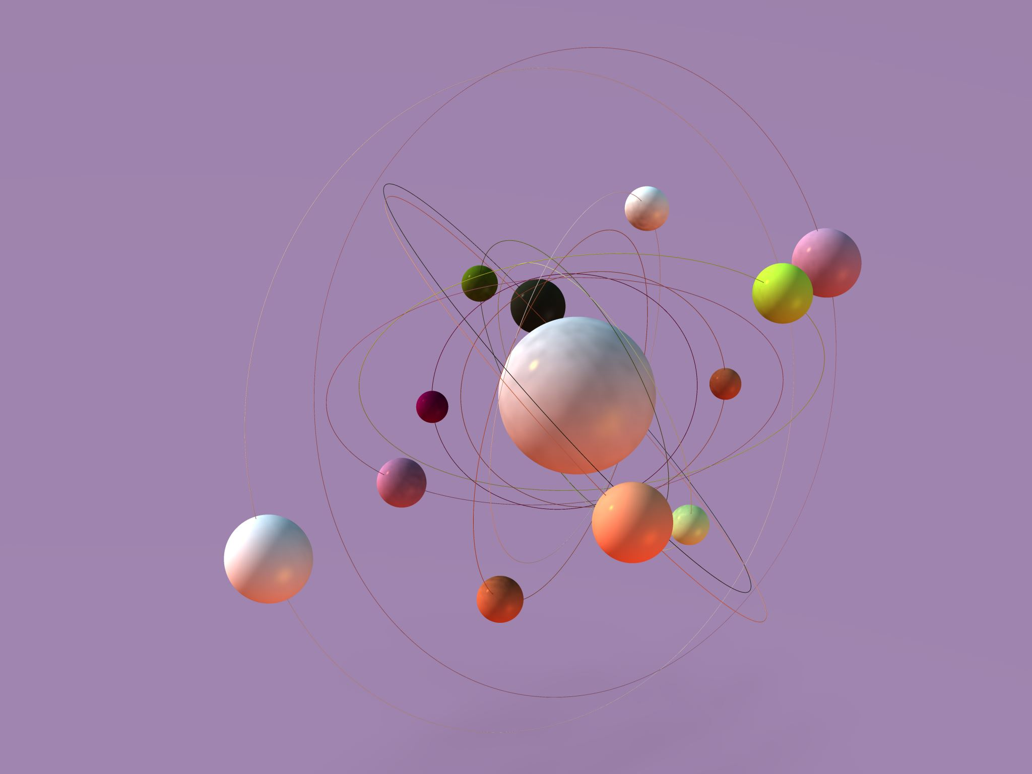
Ultimately,
We want to create an average of such behaviors analyzed across thousands of minor planets to create a general picture.

Slide 26
So, we want lots and lots of data.
We chose a random selection of 1211 named minor planets out of about 5000 total.
1211 was chosen because it initially represented computation that was the maximum of what my hardware can handle in a day.
We want to run the experiment for over 1700 + days which would result in over two million data points!

Slide 27
However,
This introduces an issue of comparing apples to oranges.
How do we compare the dozens of daily articles represented by “Ocasio-Cortez” or “Tyson” asteroids to the very few of “Chariklo”, for example?

Slide 28
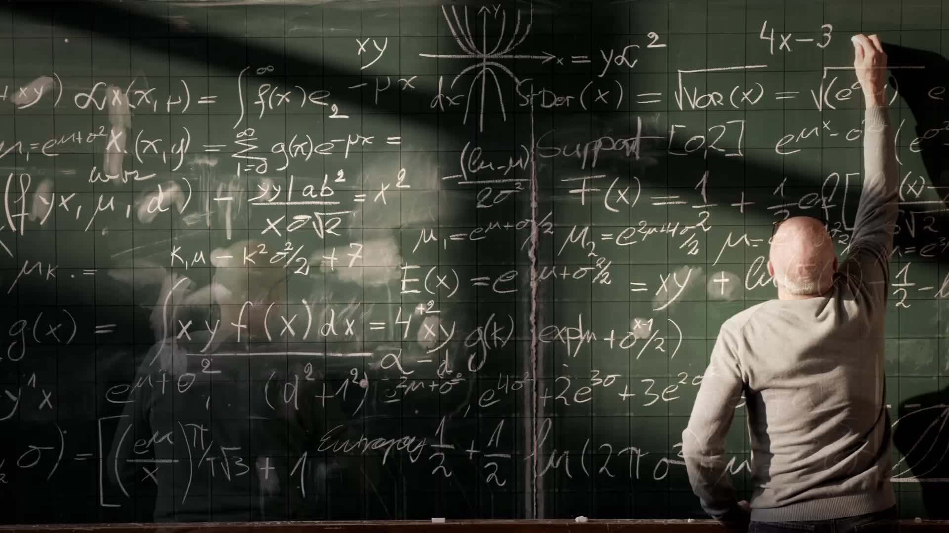
Fortunately, if you can conceive it
There is likely to be mathematics already existing for the issue!*

Slide 29
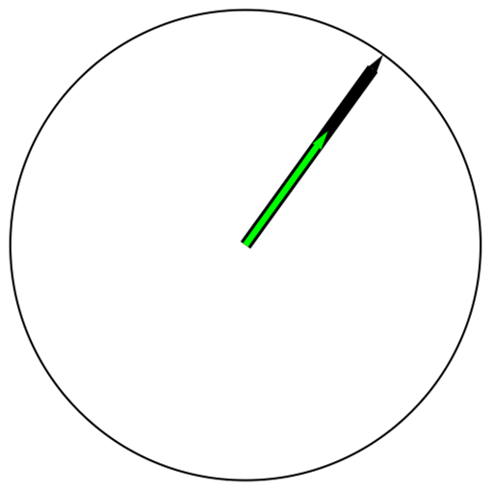
Here, the unit vector circle will be used.
“Normalization” of the article count allows each minor planet’s data to be represented accurately but relative to the same circle of radius one.

Slide 30
Don’t worry if this is not obvious.
I went to grad school for math, and I was not ever taught this particular thing, but rather, it was shown to me by a Google search.
(Grad school just teaches you what to Google.)
Math is a living, breathing subject with new developments all the time.
Again, if you can dream it, likely someone else has struggled with it too.
The math is out there.

Slide 31
Just like any art form,
Scientific principles within a study are best kept few but consistent.
The manifold complications will come in turning these into reality.

Slide 32
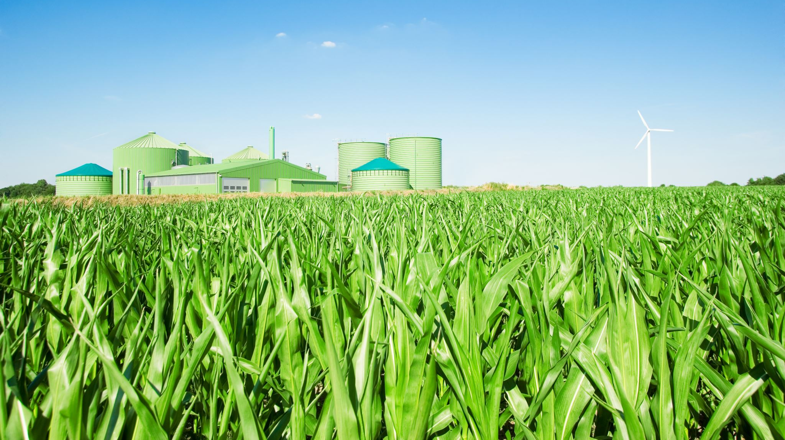
2. Data Cultivation

Slide 33
However, the ideal code was a moving target within the first six months.
Scraper methods changed.
The Google News rules for scraping changed.
The OS and code platforms themselves (Python and Mathematica) changed.

Slide 34
In a regular lab, a grad student would be dedicated as a “data wrangler” just to tend to the code.

Slide 35
Out of frustration and limitations of time,
I, in effect, hired a grad student at Fiverr.
Somewhat expensive
$200 just for the code (which is baseline for most projects),
$28 a week to run the code, clean it, and submit results to me,
but I pushed for automation, so I could avoid the weekly charge.

Slide 36
Ease is hopefully obvious, but I also needed to ensure accuracy.
This is where it was incredibly helpful that I already knew what I was looking for in the code and the expected daily results.
For example, I did fix some “bugs” in the wrangler’s code.
Lesson here is: please take a coding course!*
Even a beginner class is apt to be sufficient if you just need to manage a contractor’s code.
I recommend the courses in Python at EdX. They are free and quite good.

Slide 37
Presently, the early data is wide (1211 named minor planets out of ~5000) but not deep. (Only 87 of the desired 1700+ days are collected so far because of the delay in data wrangling.) These 105k+ data so far should still be enough to see some effect.
Consider as a simple example the minor planet Pluto
The Sun approaches and passes it yearly.
We would like at least five such rotations of the Sun around the zodiac in order to vanish sampling error.

Slide 38
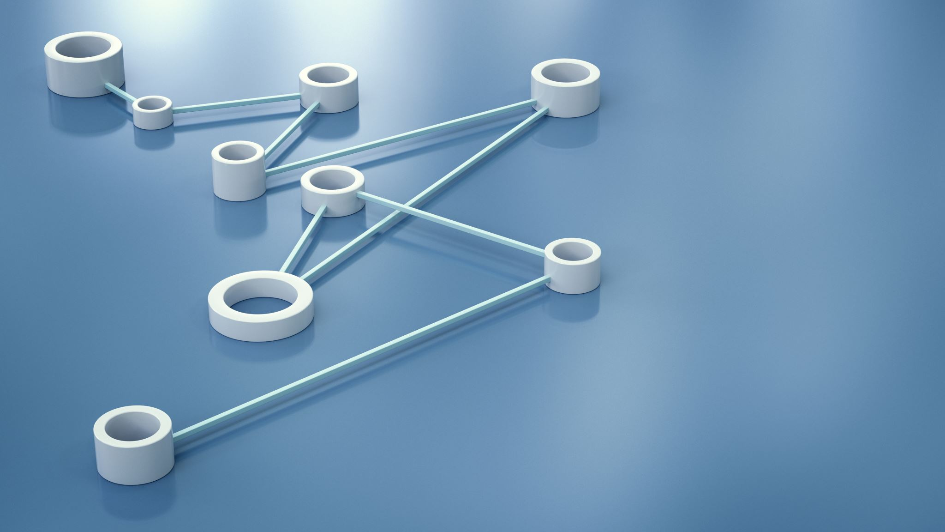
3. Data presentation

Slide 39
A thorough write-up is always needed.
Make the stories make sense in the language of the audience, not just the literal language but also the cognition space.
Even for this presentation.
Even for the whiteboard explainer video at the start of this presentation.
And for the future journal publication (one hopes).

Slide 40
As stated at the start, we would expect the results to behave like a uniform distribution if angle did not matter, but a fit there has a p-value < 10^-1355718576299610 (Cramér-von Mises method). Instead, it is following many natural phenomena’s normal distribution; p-value for fit is 0.965173 via Cramér-von Mises.

Slide 41
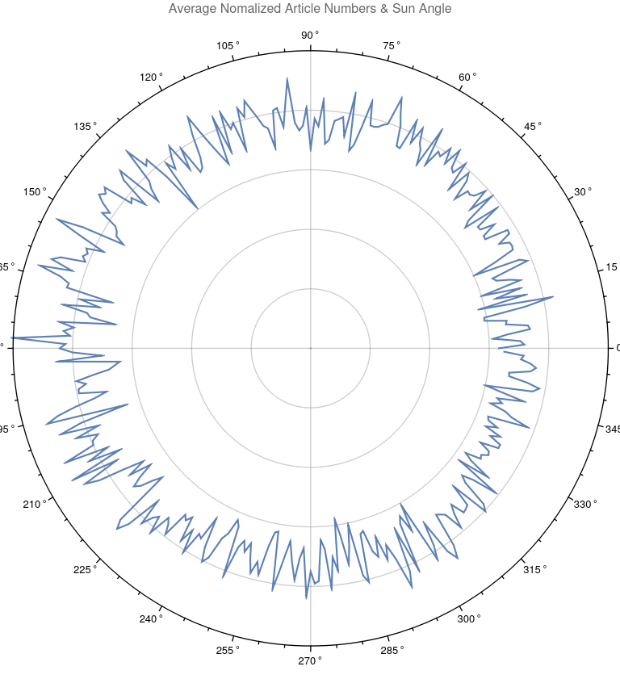
Early result: unit circle polar plot for average news articles across all the minor planets’ degrees from the Sun, n= 1211, d=87. Sampling error ~ 1% of average value. However, this visual distillation might still be too much information.

Slide 42
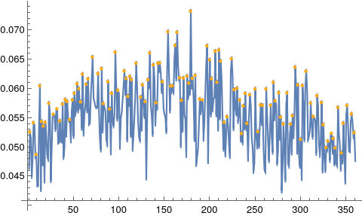
Let’s unwind the plot like we did before and look at the peaks. Can you see the pattern?
Peaks (yellow) computed based on Gaussian filter of standard deviation at degree (along x-axis) : 1, 5, 8, 12, 14, 16, 18, 22, 27, 31, 34, 37, 40, 42, 45, 48, 50, 53, 55, 57, 59, 63, 65, 70, 76, 80, 82, 87, 89, 91, 95, 98, 105, 107, 109, 111, 113, 118, 123, 125, 128, 131, 133, 137, 140, 142, 144, 147, 153, 156, 158, 161, 163, 166, 168, 170, 174, 176, 178, 180, 183, 188, 191, 196, 199, 201, 205, 207, 209, 211, 215, 218, 223, 226, 229, 232, 234, 236, 238, 240, 243, 249, 252, 255, 257, 261, 266, 269, 271, 275, 277, 280, 284, 288, 290, 293, 296, 299, 301, 305, 310, 313, 317, 322, 324, 327, 329, 333, 335, 337, 340, 344, 346, 350, 355, 358

Slide 43
y = -1.03988 + 3.07083 x ANOVA: p-value of 5.73004*10^-196

Slide 44
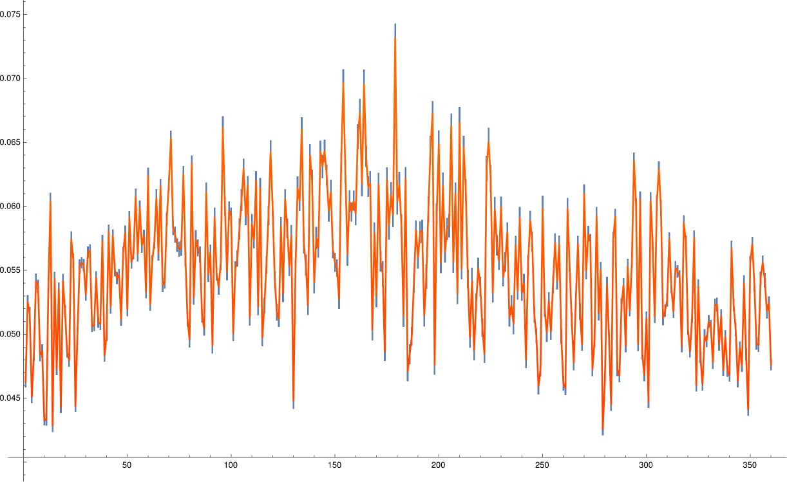
Peaks are at about midway through the three-degree mark and its 3 degree multiples! (The tenth harmonic of public life.) In blue here are the sampling errors which are very small, on average 1.0% of the actual values and never more than 1.8%.)

Slide 45
Here is the background rhythm that the peaks build on. Note the "maybe-12-ness". As we approach one million data points (10x what we have now), this should clarify.

Slide 46
Peaks of peaks moreover happen at y = -1.41923 + 2.8046 x (ANOVA p-value of 8.27696*10^-57) i.e. at the SQUARES within the D10! Perhaps this suggests that news bureaus like to cover stories that have tension. "If it bleeds, it leads." More data should help clarify this, too.

Slide 47
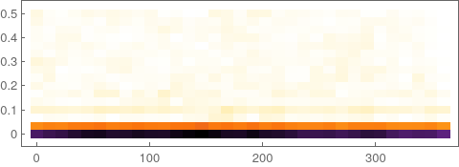
Here is the spectrogram of the emerging nascent frequency. That is, there is music starting to form.

Slide 48
(Compare to the below spectrogram of that idealized rhythm.)

Slide 49
(And compare to the below spectrogram of white noise.)

Slide 50
Final thoughts

Slide 51
I hope it is helpful to show the scientific progress mid-stream.

Slide 52
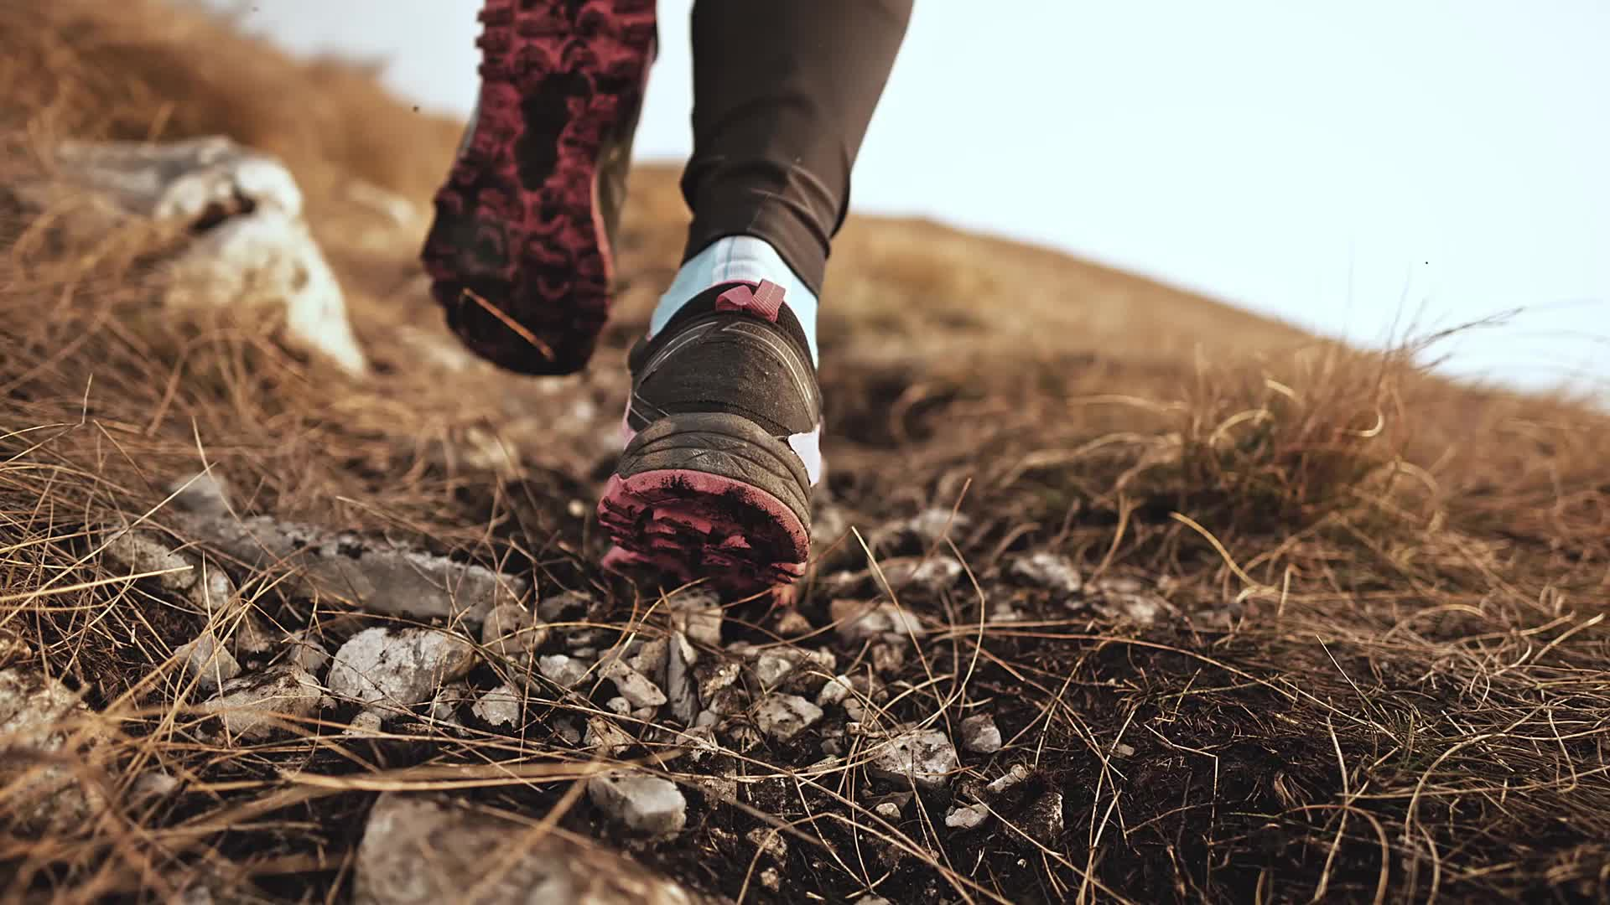
Even though we are going slow, our steps are legitimate at each level (holon) within each of the three stories.

Slide 53
It takes as long as it takes, befitting how I was taught that the natural significator of science is the great Teacher through time and Time, Saturn.
Slow (Capricorn)
and real (Capricorn and Aquarius)
and socially constructed (Aquarius)
are, in my opinion, the best approaches in science, including in your own astral research project.*

Slide 54
Some possible future directions that you could take
Separate
Separate minor planets into their categories (“Kuiper belt, Trans-Nuptunians, Plutoids, etc.)
Classify
Classify news articles by sentiment (“positive”, “negative”, really anything you want) and look for behavior to fit the sentiment
Look
Look at other data sources that deal with things happening over time (e.g. Google Trends)

Slide 55
Questions and Answers
Reach out for data and code!
AyurAstro.com
Twitter: @AyurAstro

